Slide 1
Monthly SEO Report
Website –www.Boultaudio.com
Submitted By: - To:-
Cognegiac Solutions www.Boultaudio.com

Slide 2
Detailed Seo Report

Slide 3
Boult Audio
To improve Website Traffic
Increase Lead Generation
Improve
Brand/project reputation
Increase sales revenue

Slide 4
What we offered
Business Listing
Classified Submission
Blog submission
Presentation Submission
Article submission

Slide 5
Traffic Projection-Boult Audio
Aug month Traffic (Non Paid)
Organic
CurrentUsers =26,716
Current New Users = 29,275
Current Bounce Rate =35.97%
1st Quarter
Projected Traffic (Non Paid)
Increased @25% 33,395
Projected Users =33,395
Projected New Users = 33,375
Current Bounce Rate - (Minus -2% )
2nd Quarter
Projected Traffic (Non Paid)
Increased @ 50% 40,074
Projected Users =40,074
Projected New Users=40,050
Current Bounce Rate - (Minus -2% )
3rd Quarter
Projected Traffic (Non Paid)
Increased @ 75% 46,753
Projected Users = 46,753
Projected New Users = 20,025
Current Bounce Rate - (Minus -2% )
4th Quarter
Projected Traffic (Non Paid)
Increased @100% 53,432
Projected Users =53,432
Projected New Users =26,700
Current Bounce Rate - (Minus -2% )
Time Line |  | Next Projected Traffic ( Only Organic)
1st Quarter |  | 33,395
2nd Quarter |  | 40,074
3rd Quarter |  | 46,753
4th Quarter |  | 53,432
Total |  | 1,73,654

Slide 6
Organic Data
20 August To 31
Users | Sessions | Bounce Rate | Page Session
19,465 | 26,860 | 32.77% | 4.07
September
Users | Sessions | Bounce Rate | Page Session
61,640 | 91,400 | 37.41% | 3.84
October
Users | Sessions | Bounce Rate | Page Session
97,084 | 151,171 | 36.83% | 3.55
November
Users | Sessions | Bounce Rate | Page Session
53,683 | 79,432 | 38.27% | 3.01

Slide 7
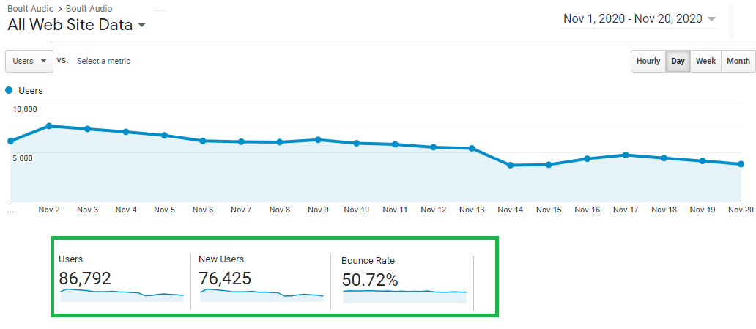
Current Month Traffic Projection
No. of users in Current month are 86,792

Slide 8
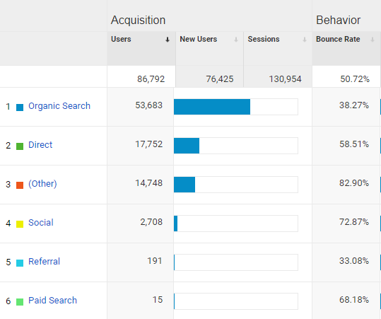
Channels Overview Current Month
Organic Search Users are 53,683 in Nov

Slide 9
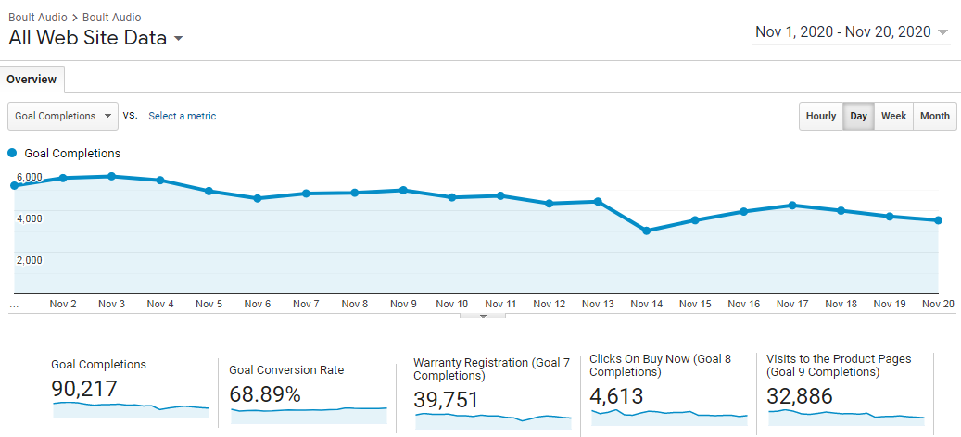
Conversion Overview- Nov Month

Slide 10
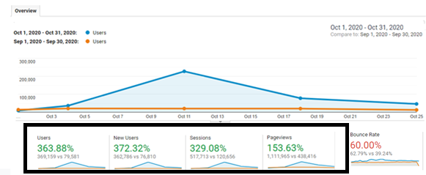
Traffic Projection OCT Month
No.of users in October(369159) were increased by 363.88% as compare to September (79581)

Slide 11
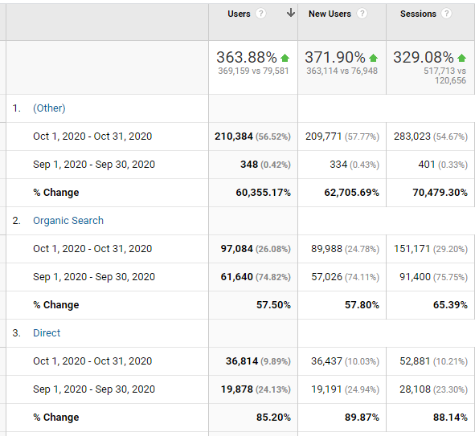
Organic Search Traffic Projection Oct Month
Organic Search Improvement 57.50% In Oct Month As Compare To Sep Month

Slide 12
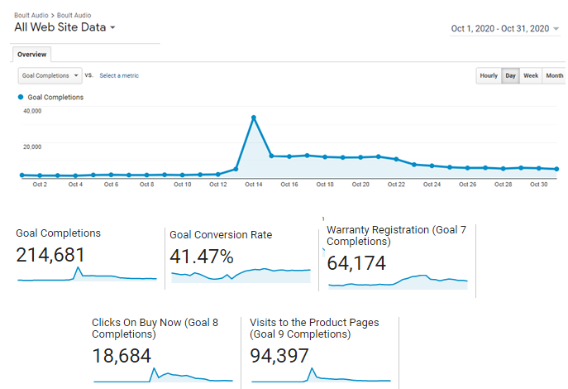
Conversion Overview- Oct Month

Slide 13
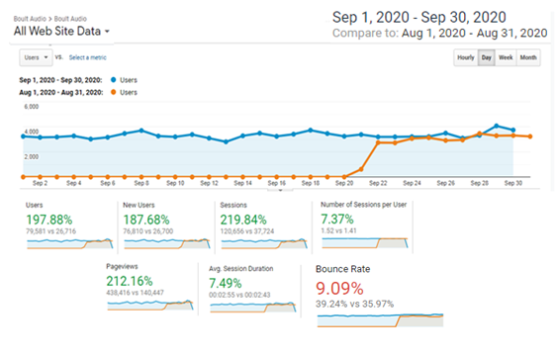
Traffic Projection in Sep Month
No.of users in September(79581) were increased by 197.88% as compare to August(26716)

Slide 14
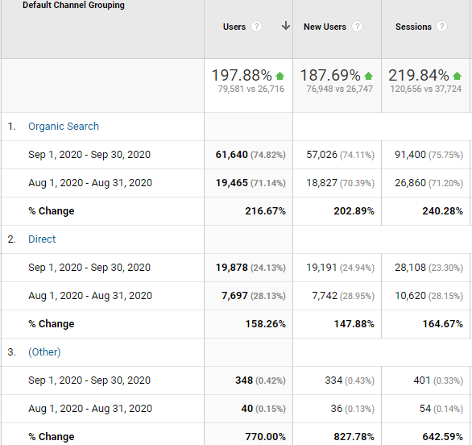
Organic Search Traffic Projection Sep Month
This channel include traffic from all search engines. Organic Users in Sep were 61,640 as compare to Aug 19,465

Slide 15
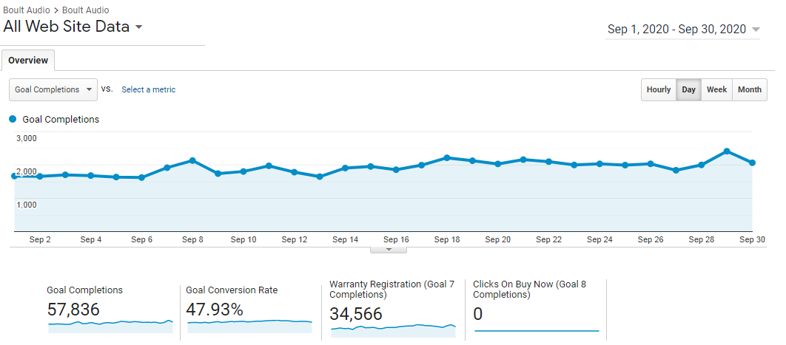
Conversion Overview- Sep Month

Slide 16
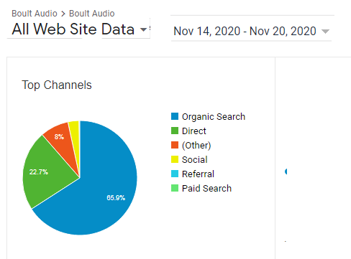
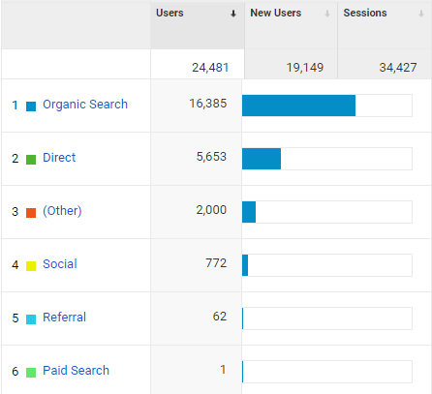
Organic Search Traffic Projection Nov Month

Slide 17
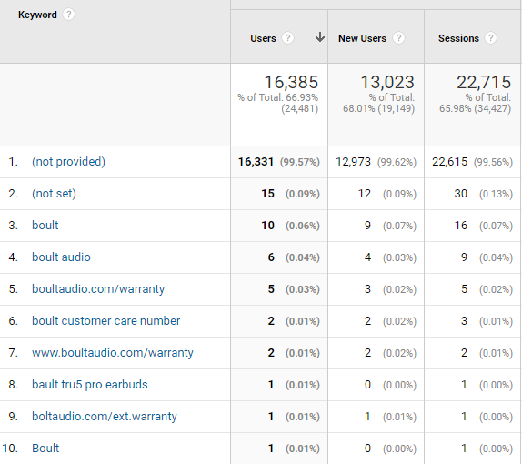
Organic Search keywords

Slide 18
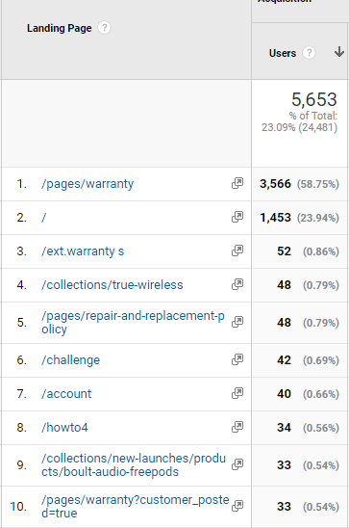
Direct Traffic Over view Nov

Slide 19
Branded Keywords Improvement
Keyword | 11th Sep'20 (Google India) | Oct | 02-Nov
boult TrueBuds | new | 4 | 1
boult FreePods | new | 4 | 1
boult ProPods | new | 6 | 3
boult audio ProPods | new | 6 | 3
boult audio flowx | 1 | 1 | 1
boult space | 6 | 3 | 1
boult audio space | 5 | 3 | 2
Boult Audio Curve | 2 | 1 | 2
Boult Sonic | 5 | 3 | 4
Boult Muse | 8 | 7 | 7
Boult Audio Muse | 8 | 8 | 2
boult bluetooth headphones | 4 | 1 | 4
boult audio ranger | 3 | 3 | 1
Boult Audio Flex | 9 | 3 | 3
Boult Audio Boost | 5 | 3 | 2
Boult Boost | 12 | 3 | 4
boult audio tru5ive pro | new | 14 | 1

Slide 20
Non-Branded Keywords Improvement
 | 16th Sep'20 (Google India) | oct -month ranking | 02-Nov
truly wireless earbuds | Not in 100 | Not in 100 | 64
earpods bluetooth price | Not in 100 | Not in 100 | 56
wireless headphones price | 78 | 79 | 74
bluetooth headset price | Not in 100 | 62 | 54
latest earphones | Not in 100 | Not in 100 | 80
earpods bluetooth price | Not in 100 | 88 | 62
upcoming bluetooth earphones | Not in 100 | 88 | 64
earpods bluetooth price | Not in 100 | 88 | 61
bluetooth handsfree buy online | Not in 100 | 80 | 78
truly wireless earbuds | Not in 100 | Not in 100 | 60
wireless headphones price | Not in 100 | 95 | 80
bluetooth handsfree buy online | Not in 100 | 80 | 66
bluetooth handsfree buy online | Not in 100 | 80 | 66
bluetooth handsfree online | Not in 100 | 87 | 68
headphones wireless bluetooth price | Not in 100 | 78 | 73

Slide 21
Sep Month Plan
Activity | Report as Deliverable - Yes/No | Cog-Team-Status
Website Technical Analysis | Yes | DONE
Competitive Analysis | Yes | DONE
Keywords Research & Analysis | Yes | DONE
Initial Rank Report | Yes | DONE
URL Mapping | Yes | DONE
URLs Rewriting (If Required) | Yes | DONE
Google Analytics Account Setup (If Required) | Yes | already set up
Submission of Website in Google Webmaster Tool (If Required) | Yes | DONE
Title & Meta Tags Optimization of Targeted Pages | Yes | DONE
H1 Tags Optimization of Targeted Pages | Yes | NOT REQUIRED
Web Content Duplicity Check | Yes | DONE
Canonical Optimization (If required) | Yes | DONE
Penguin/ Panda Impact Check | Yes | DONE
Broken Links Check | Yes | DONE
Social Bookmarking - 100 | Yes | Done
Classified Submissions - 100 | Yes | Done
Directory Submission - 20 | Yes | Done
Google Local Business Listing Creation/ Optimization ( If Required) | Yes | already set up
Rank Reporting and Traffic Analytics Reporting - 1 | Yes
Monthly Invoice for Month - 2 | Yes

Slide 22
Oct Month Plan
XML Sitemap Creation | Yes
Image Alt Tags Optimization | Yes | DONE
Robots.txt File Creation | Yes | DONE
Web Content Optimization | Yes | INFUTURE
Installation Internal Blog into website ( If Required.) | Yes | INFUTURE
Internal Blog Content Creation | 3 | INFUTURE
Image Share 5 | 5 | DONE
Article Submission ( Single Content Single Resources) | 3 | done
Blog Submission ( Single Content Single Resources) | 3 | done
Social Profile linking 3*5 | 15 | DONE
Guest Posting Live Links SBM | 5 | DONE
Forum Live Links SBM 1*5 | 5 | DONE
PPT creATION | 4 | DONE
PDF creation | 4 | DONE
Video Submission 1*5 | 5 | DONE
Question/Answer ( BOOKMARKING) | 25 | DONE
Question/Answer ( Q/A Writing by Client Team) | 5 | DONE
(Relevant/Non-spammy) Industry Directories | 25 | DONE
Blog commenting | 5 | DONE
Video Commenting | 5 | DONE
Blog Live Links SBM 3*5 | 15 | Done
PPT Live Links SBM 4*5 | 20 | DONE
Forum Commenting | 4 | DONE
Social Commenting | 4 | DONE
Video Live Links SBM | 5 | DONE
Q/A Live Links SBM 4*5 | 5 | DONE
Ping Submission | 40 | DONE
Guest Posting | 1 | DONE
Niche Forum Profile Links | 5 | DONE
Article Live links SBM 3*5 | 15 | Done
PDF Live Links SBM 4 *5 | 20 | DONE
Monthly Report | YES

Slide 23
Nov Month Work Plan
Activity | Report as Deliverable - Yes/No | Cog-Team-Status
Google Webmaster Review | Yes
Internal Linking Optimization | Yes
Page Size Optimization | Yes
Blog Content Creation | 3
Image Share | 5
Article Submission ( Single Content Single Resources) | 3
Blog Submission | 3
Social Profile linking | 5
Guest Posting Live Links SBM 1*5 | 1
Forum Live Links SBM | 2
PPT Submission | 4
PDF Submission | 4
Video Submission | 4
Question/Answer ( Q/A Writing by Client Team) | 5
Blog commenting | 5
Video Commenting | 5
Blog Live Links SBM 3*5 | 15
PPT Live Links SBM 4*5 | 20
Forum Commenting | 2
Social Commenting | 2
Product listing | 10
Video Live Links SBM 4*5 | 20
Q/A Live Links SBM 5*5 | 25
Ping Submission | 50
Guest Posting | 1
PR Posting | 1
Niche Forum Profile Links | 5
Social Media Post Links | 20
Article Live links SBM 3*5 | 15
PDF Live Links SBM 4*5 | 20
Total Monthly | 244

Slide 24
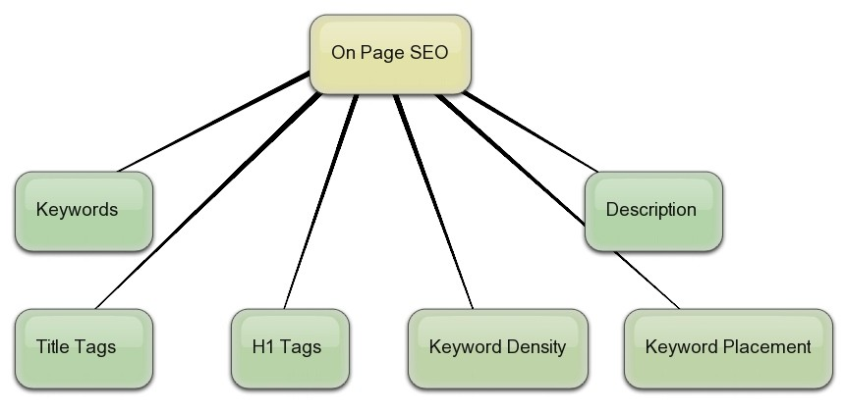
On page Activities
On Page Analysis
These are most important factors of optimizing a website. Proper implementation will help keywords ranking in search engine for your website.

Slide 25
Meta Tags optimization
In this phase we have optimized Meta Tags for all pages. They are used to describe your website in search engine results.
Sr. No. | Details | Maximum Limit | Current Status | Comments
1. | Meta Title Tags | 60-70characters with space | TITLE TAGS ARE IMPLEMENTED ON LIVE PAGES |  | Title tags are optimized for live pages.
2. | Meta Description Tags | 160-170 characters with space | meta descriptionis updated on live url. |  | Meta Descriptions are updated on website
3. | Header Tags | H1, H2, H3, H4, H5 & H6 | Not reuired in a product based website. |  | Not reuired in a product based website.
4. | Bold Tags | As per the need | Not reuired in a product based website.. |  | Not reuired in a product based website.
5. | Alt & Title Attributes | As per the images | <img> Tags implemented. |  | Implemented images & ALT tags.

Slide 26
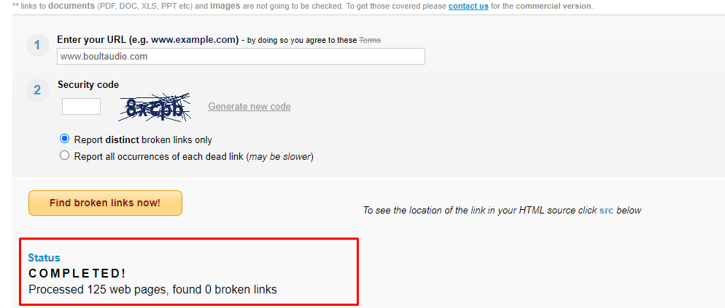
BROKEN LINK CHECK
Broken links are links that don’t work. Links to your website and links within your website can affect where your website ranks in search results.
Result: Broken links are not found in our website

Slide 27
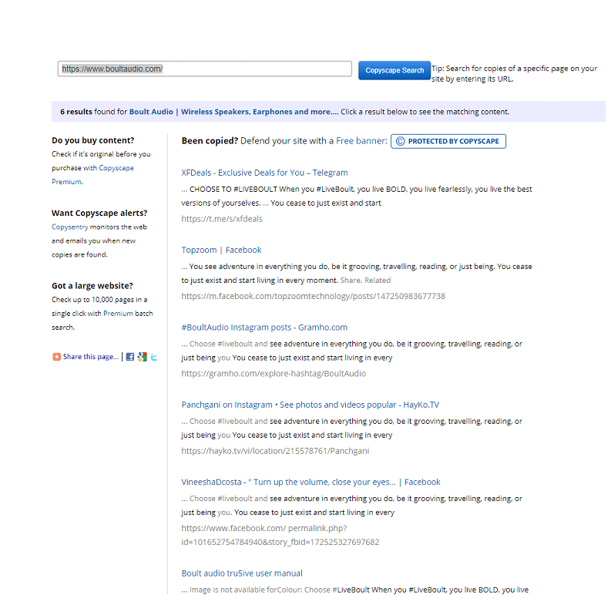
Content Duplicacy Check
Duplicate content is content that appears on the Internet in more than one place. so, if the same content appears at more than one web address, you’ve got duplicate content.
Result: The website has no duplicate content.

Slide 28
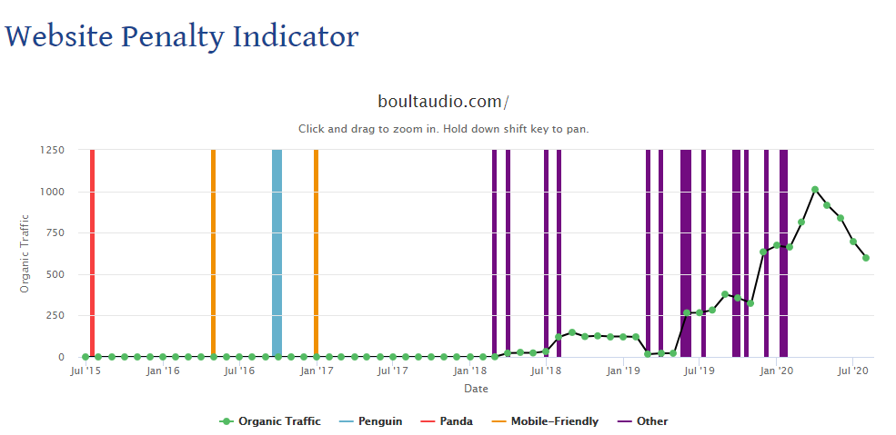
Google Banned URL Check
This check looks to see if a URL has been banned from Google, this can be a variety of reasons and action needs to be taken if it has been removed from index.
Result: Website is not hit by the panda and penguin, please refer to presented below screenshot

Slide 29
Sitemap.xml
Robots.txt
A sitemap is an essential for every website in order to keep the website linked well; each page should be at least linked to the sitemap. A good website infrastructure allows the search engines spiders to crawl the entire website and therefore ensure all pages of the website are present in the indexes of the major search engines.
Result: We have updated Sitemap.xml file on the website
Robots.txt file restricts the activity of search engines crawlers and stops from accessing certain pages and directories. A robots.txt file also locates the XML sitemap.
Result: We have updated Robots.txt file on the website

Slide 30
Canonical URL Check
A canonical problem exists where a site can be found by using the www version (http://www.boultaudio.com/) and the non-www version (http://boultaudio.com/). This creates a problem because it can be seen as duplicate content by the search engines and one version can be removed from their indexes - the problem arises when the wrong version is deleted (this is usually the non-www version).
Result: Cannonical is already updated on a website, not required

Slide 31
LOCAL CITATION
Off PAGE Activities
LOCAL CITATION |  | Status
https://www.iglobal.co/united-states/new-delhi/boult-audio | LIVE
http://tupalo.com/en/new-delhi/boult-audio | LIVE
https://www.tuugo.in/Companies/boult-audio/0150008330616 | LIVE
https://www.callupcontact.com/b/businessprofile/Boult_Audio/7544265 | LIVE
https://www.owler.com/company/boultaudio | LIVE
https://www.cybo.com/IN-biz/boult-audio_10 | LIVE
https://www.trepup.com/boult-audio/stories/309772 | LIVE
https://www.loclists.com/listing/top-10-latest-earphones-with-low-price-in-india/ | LIVE
http://www.businessmention.in/en/business/boult-audio | LIVE

Slide 32
Social Bookmarking Sites
Social Bookmarking List | Status
https://www.diigo.com/user/boultaudio | Best earphones brand, earphones best brands, best wireless Bluetooth
https://www.scoop.it/topic/boult-audio/p/4121040748/2020/09/29/best-branded-wireless-earphones-at-reasonable-prices | Best earphones brand, earphones best brands, best wireless Bluetooth
https://slashdot.org/~BoultAudio | Best earphones brand
https://tutpub.com/others/best-branded-wireless-earphones-at-reasonable-prices/ | Best earphones brand
https://www.diigo.com/user/boultaudio | Best earphones brand, earphones best brands, best wireless Bluetooth
https://www.scoop.it/topic/boult-audio/p/4121040748/2020/09/29/best-branded-wireless-earphones-at-reasonable-prices | Best earphones brand, earphones best brands, best wireless Bluetooth
https://boultaudio.tumblr.com/ | Bluetooth Headset, boult Bluetooth earphones
https://www.clipix.com/9/share-fOLrMWoq | Bluetooth Headset, boult Bluetooth earphones
https://www.yemle.com/news/boult-audio---cheap-wireless-headphones-price-in-india | best wireless headphones, cheap wireless headphones, wireless headphones price, wireless headphones, wireless headphones price in india
http://yousticker.com/BoultAudio#/BoultAudio/page/0?lang=en&privacy=2&view=fullView&range=1 | best wireless headphones, cheap wireless headphones, wireless headphones price, wireless headphones, wireless headphones price in india

Slide 33
PPT Submission
Link |  | Status
https://www.powershow.com/view/9125db-MmQ0Y/Boult_Audio_-_Buy_Truly_Wireless_Headphones_powerpoint_ppt_presentation | LIVE
https://issuu.com/boultaudio/docs/amazonoffers-boultaudio.pptx | LIVE
https://www.4shared.com/file/lJh71Igoea/top_wireless_earphones.html# | LIVE
https://www.slideshare.net/gurdeepallied/best-noise-canceling-headphones-of-2020 | LIVE

Slide 34
Article Submission
Link |  | Status
https://headphonesdeals4u.blogspot.com/2020/10/top-4-boult-audio-over-ear-headphones.html | LIVE
https://scooparticle.com/4-best-earphones-you-can-buy-in-india-within-rs-1000/ | LIVE
https://bluetoothearphones679508300.wordpress.com/2020/10/27/best-boult-audio-truly-wireless-earbuds-2020/ | LIVE
https://techmoab.com/top-4-portable-and-economical-bluetooth-speakers-in-2020/ | LIVE

Slide 35
Classified Submission
Classified list | Title
https://delhi.advertclassifieds.in/view/339070/boult-audio-headphones-with-mic-for-good-music/ | Boult Audio Headphones With Mic For Good Music
https://ad4u.in/ad/1577/boult-audio-headphones-with-mic-for-good-music | Boult Audio Headphones With Mic For Good Music
https://eventsking.com/288/posts/4-for-sale/55-electronics/911198-Wireless-bluetooth-headphones-with-mic-now-available-online.html | Wireless bluetooth headphones with mic now available online
http://www.adsyellowpages.com/electronics/computer-peripherals/wireless-bluetooth-headphones-with-mic-now-available-online-1774136.htm | Wireless bluetooth headphones with mic now available online
http://www.gofreeclassified.com/for-sale/electronics/buy-online-boult-wireless-audio-space-in-earphones_i74024 | Buy online Boult Audio wireless audio space in-earphones
http://clickadlink.com/newsite/ad/boult-audio-boult-storm-wired-earphones/ | Boult Audio - Boult STORM Wired Earphones
http://www.adskorner.com/electronics/computer-peripherals/boult-audio-buy-boult-wired-earphones-online-in-india-1301670.htm | Boult Audio - Buy wired earphones online in India
http://www.adport.in/965-boult-audio-buy-boult-wired-earphones-online-in-india/details.html | Boult Audio - Buy wired earphones online in India
http://www.adskorner.com/electronics/computer-peripherals/boult-audio-buy-boult-wired-earphones-online-in-india-1301670.htm | Boult Audio - Buy wired earphones online in India
https://delhi-dl-in.global-free-classified-ads.com/listings/upcoming-bluetooth-headset-and-earphones-available-in-india-it13370315.html | Upcoming Bluetooth headset and earphones available in India

Slide 36
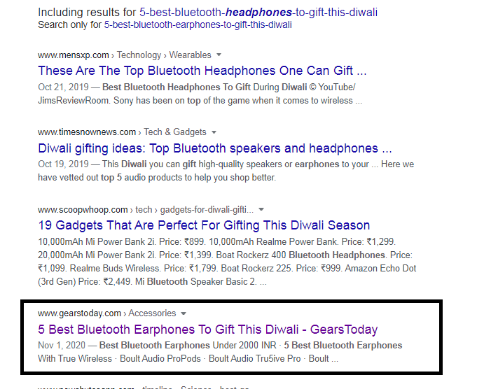
Guest Post
Link |  | Status
https://www.gearstoday.com/accessories/5-best-bluetooth-earphones-to-gift-this-diwali/ | LIVE
Ranking In top 5 with
5 best bluetooth headphones to gift this diwali

Slide 37
Q/A POSTING
Question/Answer Posting
Sr. No | Question Link | Answer Link | Status
1 | https://www.quora.com/unanswered/Which-headphones-are-the-best-for-under-2000-Rs | https://www.quora.com/Which-headphones-are-the-best-for-under-2000-Rs/answer/Namita-Kapoor-36?__filter__=all&__nsrc__=1&__sncid__=8701159355&__snid3__=12799982926 | Live
2 | Which company's headphones are the best? | https://www.quora.com/Which-company-makes-the-best-headphones/answer/Aanchal-Sehgal-3?prompt_topic_bio=1 | Live
3 | What are some of the most popular headphones for gaming? | https://www.quora.com/What-are-some-of-the-most-popular-headphones-for-gaming/answer/Mahak-Malhotra-10 | Live
4 | https://www.quora.com/What-are-some-good-quality-Bluetooth-headphones | https://www.quora.com/What-are-some-good-quality-Bluetooth-headphones/answer/Mahak-Malhotra-10?prompt_topic_bio=1 | Live
5 | https://www.quora.com/What-headphones-do-you-use-Why | https://www.quora.com/What-headphones-do-you-use-Why/answer/Namita-Kapoor-36?prompt_topic_bio=1 | Live

Slide 38
Forum Comment
Forum Comment
Sr. No. | Links | Comment | Status
1 | https://forums.tomsguide.com/threads/why-do-my-hesh-2-0-wireless-headphones-make-screeching-noises-on-high-bass-or-loud-noises.473422/ | Have you ever tried the boult audio wirless headphones? I recently bought a Boult Audio Headphone. The sound is good as it has passive noise cancellation, and the extra bass is just so good. I have never faced this type of disturbance or problem with my headphone. | Live
2 | https://www.silabs.com/community/wireless/bluetooth/forum.topic.html/best_sound_wirelessheadphones-mvVe | If you are planning to purchase a pair of wireless headphones then boult audio is the best buy. I am using boult audio headphones for the past 5 months and have never faced any issue. The sound quality is good as they come with passive noise cancellation, and the extra bass gives you immense sound pleasure. | Live
3 | https://forums.audioholics.com/forums/threads/best-bluetooth-headphones.109881/ | I'll recommend the Boult Audio Boost headphones because these headphones are designed very carefully to match your lifestyle with a stunning soft headband and comfortable earcups. I've been using these headphones for the past 5 months, and I am happy with the build quality of these headphones. | Live

Slide 39
Video Comment
Video Comment
Sr. No. | Links | Comment | Status
1 | https://www.youtube.com/watch?v=xOgUVI1cwOw | The best speaker within the price range, I have been using this for the past 2 months, and I must say the sound quality is superb. Design-wise the speaker is sleek yet classy and will compliment anyone's lifestyle. It's compact and lightweight, which makes it comfortable for your travel sessions. | Live
2 | https://www.youtube.com/watch?v=MGrLPQRqcrw | I am also using the Boult Audio Probuds, and I want to tell you that it's worth the money. You can enjoy the crystal clear audio with the Probuds, and the voice assistant pairs with your phone's assistant, which is a boon for me during workouts, it's waterproof, so you don't have to worry about it during your gymming sessions, and you can feel the extra bass.. | Live
3 | https://www.youtube.com/watch?v=-b2iqtIGpoY | I had bought the boult audio thunder headphones 3 months ago, It gives me a 7+ hours battery life, the comfortable earcups let me enjoy an uninterrupted gaming experience. It also has passive noise cancellation, due to which my gaming experience enhances by 200%. | Live

Slide 40
What We Deliver
Monthly Ranking Report
Monthly SEO Traffic Report
Content Developed for Syndication
Article and Press Release Submission Report
Search Engine Submission report

